Slide 1
Obesity-Lifestyle Trends - Eating Habits and Physical Condition
Uncovering the Intersection of Genetics, Lifestyle, and Demographics
Presenter Name: Shamdina P
Date: April 2026

Slide 2
Project Overview & Objectives
The Goal: To identify which behavioral and biological factors most strongly correlate with different obesity levels.
The Data: 2,111 records covering demographics, eating habits, and physical conditions.
Core Question: Is obesity driven more by daily choices (transportation/diet) or inherent factors (genetics/age)?

Slide 3
Methodology & Data Integrity
Dataset Size: 2,111 records with 17 attributes.
Data Balancing: 77% of the data was generated via SMOTE (Synthetic Minority Over-sampling Technique) to ensure equal representation of all 7 obesity categories.
Cleaning Process: Rounded numerical values (Age, Meals) and standardized column names for better readability.

Slide 4
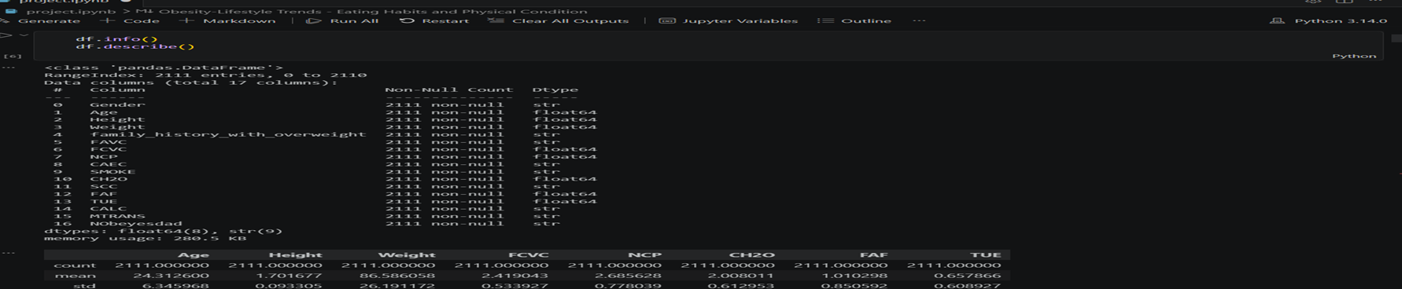

Slide 5
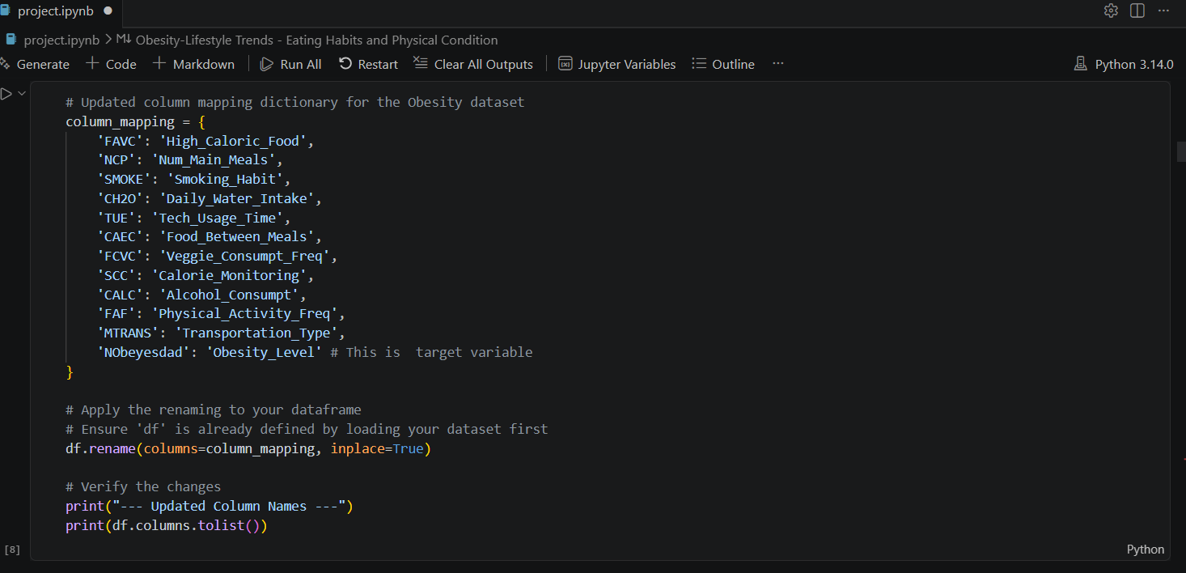

Slide 6
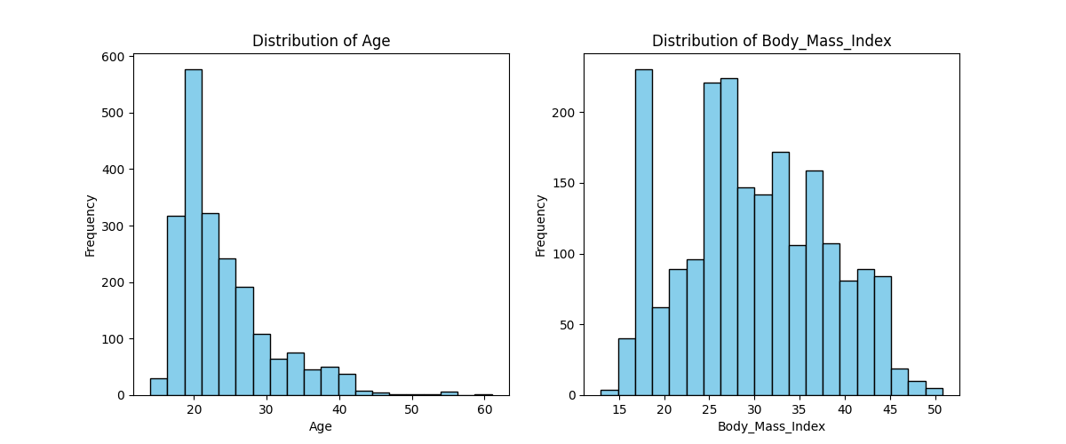
Demographic Snapshot (Age & BMI)
Key Insights:
Young Adult Focus: The dataset is heavily skewed toward the
18–25 age bracket.
High Average BMI: The mean BMI is 29.7, placing the
average participant on the verge of clinical obesity.
Notes:
Our study primarily looks at young adults. This is a critical window where lifestyle habits often solidify for a lifetime.

Slide 7
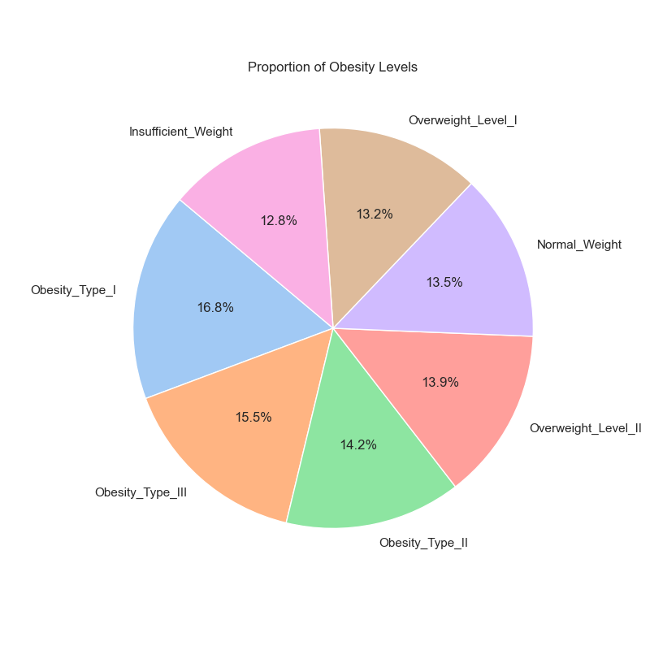
Class Distribution
The data is evenly balanced (~14% for each of the 7 levels).
Significance: This balance is vital for machine learning; it prevents the model from being biased toward any specific weight category.

Slide 8
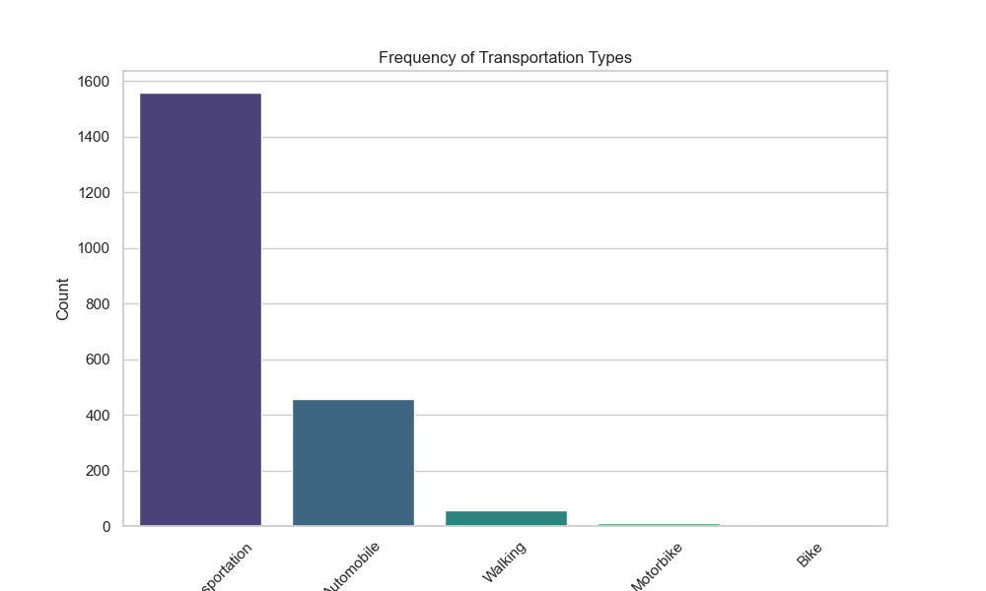
Environmental Risk: Transportation
96%+ of individuals rely on public transit or private cars.
Active commuting (walking/cycling) is nearly non-existent.
Conclusion: Passive transport is a "common denominator" for weight gain in this population.

Slide 9
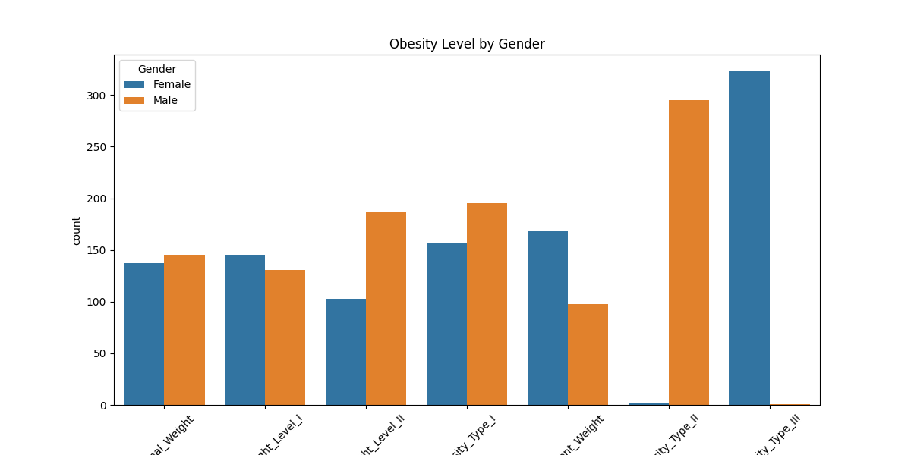
The Gender Split in Obesity
Obesity Type III is almost exclusively female.
Obesity Type II is almost exclusively male.
Notes:
This is a key biological finding. Severe obesity manifests differently across genders, which is a critical feature for our classification logic."

Slide 10
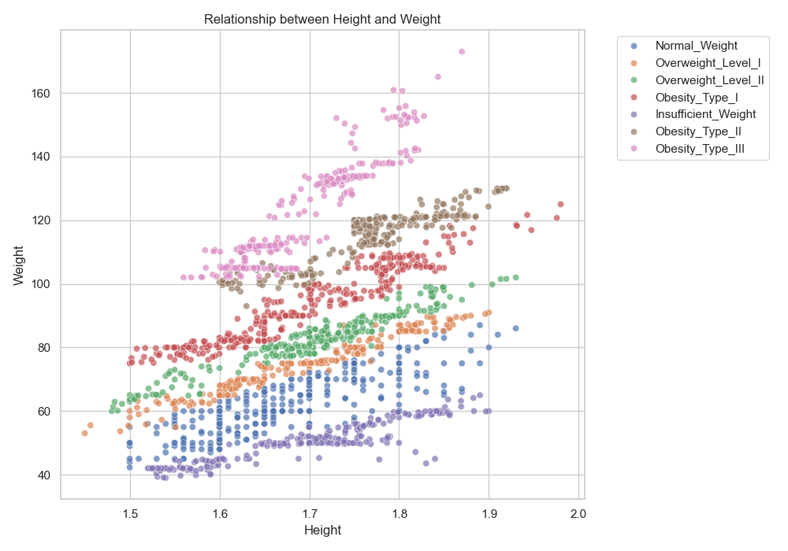
Height vs. Weight: The BMI Bands
The plot shows clear "diagonal bands" for each obesity category.
It visualizes the mathematical boundary where height no longer "buffers" weight gain.

Slide 11
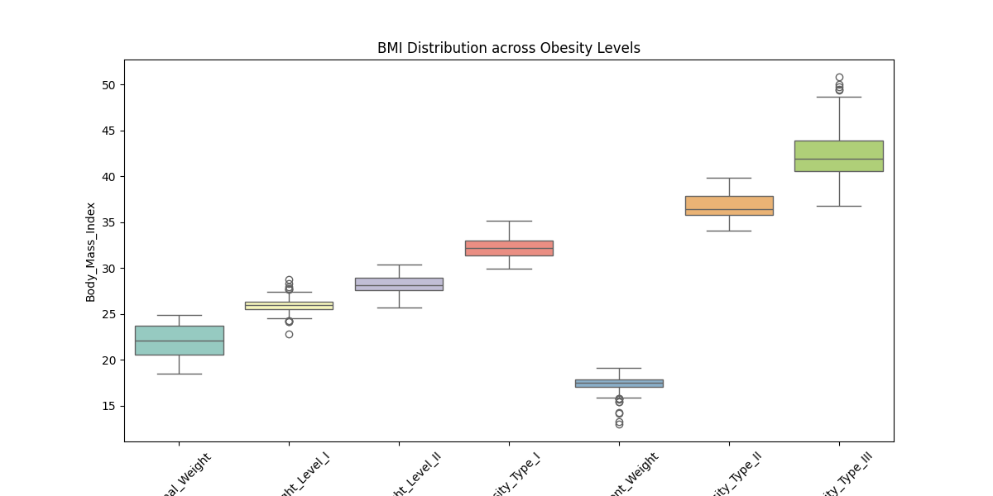
Advanced View: BMI by Gender
Shows the exact range of BMI within each obesity category.
Confirms that BMI thresholds remain consistent, but the frequency within those thresholds is gender-dependent.

Slide 12
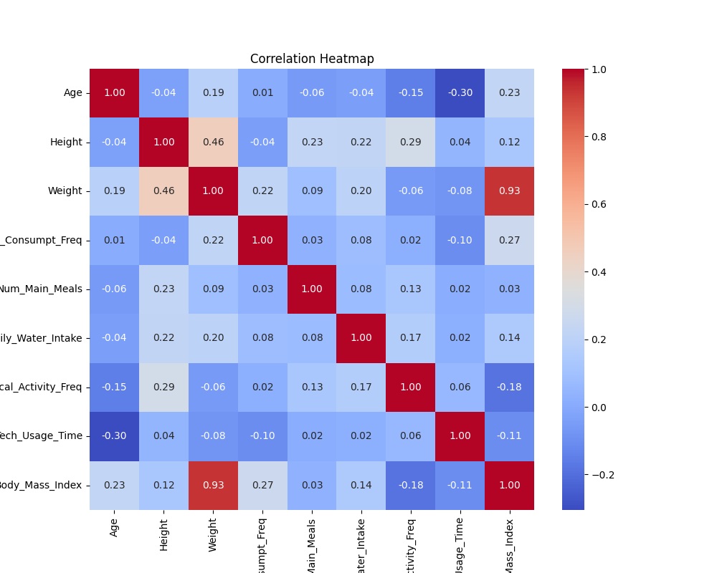
Mapping Relationships (Correlation)
Weight and Age show a positive correlation (weight tends to increase as people enter their late 20s).
Family History is the strongest underlying categorical predictor.
Notes:
The heatmap confirms that as age increases, BMI follows a rising trend, specifically between ages 20 and 35."

Slide 13
Final Summary & Conclusions
Key Driver 1: Genetics. 82% of the population has a family history of overweight
Key Driver 2: Lifestyle. Sedentary transportation and high-calorie diets are the primary environment.
Key Driver 3: Biology. Gender determines the classification of extreme obesity types.

Slide 14
Actionable Recommendations
Target Audience: Young adults (18–25) with a family history of overweight.
Intervention: Promote "active commuting" (walking/biking) to break the sedentary transit cycle.
Future Modeling: Use Weight, Age, and Family History as the primary features for early health screening tools.

Slide 15
THANK YOU

